Slide 1

Missing child detection
L&T software technologies
III DCME
This Photo by Unknown Author is licensed under CC BY

Slide 2
Contents:
Abstract
Introduction
System Architecture
Existing System
Proposed System
Advantages
Disadvantages
Screenshots
Conclusion

Slide 3
Abstract
In India a countless number of children are reported missing every year. Among the
missing child cases a large percentage of children remain untraced.
This paper presents a novel use of deep learning methodology for identifying the reported missing child from the photos of multitude of children available, with the help of face recognition..
The photo will be automatically compared with the registered photos of the missing child rom the repository.
The Convolutional Neural Network (CNN), a highly effective deep learning technique for image based applications is adopted here for face recognition Face descriptors are extracted from the images using a pre-trained CNN model VGG Face deep architecture.

Slide 4
Introduction
A deeply disturbing fact about India’s missing children is that while on an average 174 children go missing every day, half of them remain untraced. Children who go missing may be exploited and abused for various purposes. As per the National Crime Records Bureau (NCRB) report which was cited by the Ministry of Home Affairs (MHA) in the Parliament (LS Q no. 3928, 20-03- 2018), more than one lakh children (1,11,569 in actual numbers) were reported to have gone missing till 2016, and 55,625 of them remained untraced till the end of the year.
The child missing from one region may be found in another region or another state, for various reasons. So even if a child is found, it is difficult to identify him/her from the reported missing cases. A framework and methodology for developing an assistive tool for tracing missing child is described in this .

Slide 5
Existing System
Earliest methods for face recognition commonly used computer vision features such as HOG, LBP, SIFT, or SURF
However, features extracted using a CNN network for getting facial representations gives better performance in face recognition than handcrafted features.

Slide 6
Proposed System
Here we propose a methodology for missing child identification which combines facial feature extraction based on deep learning and matching based on support vector machine.
The proposed system utilizes face recognition for missing child identification.

Slide 7
Advantages
By training the CNN model, it is possible to identify missing children by extracting high-level features from photos.
The deep learning model becomes resistant to many elements such as noise, lighting, occlusion, image pose, and child age by choosing the best CNN model and undergoing appropriate training.

Slide 8
Disadvantages
Here we use CNN which leads to following
disadvantages :
High computational requirements.
Training takes a long time

Slide 9

Screenshots
In the screen public can click on ‘Public Upload Suspected Child’ link to get below page and to add missing child details.

Slide 10

Screenshots
The public can upload images from here

Slide 11

Screenshots
Upload was successfully completed and acknowledgment is given

Slide 12
Screenshots
Upload was successfully completed and acknowledgment is given . But in the screen we can see child not found in missing DB and we can try with other image

Slide 13

Screenshots
Here we select another image

Slide 14

Screenshots
Upload was successful and child found in the missing database.

Slide 15

Screenshots
In this screen admin can login by entering username and password as ‘admin’ and ‘admin

Slide 16

Screenshots
After clicking on ‘Login’ button will get the screen like this-→
In this screen official can click on ‘View Public Upload Missing Childs Status’ link to view all uploads and its result done by public

Slide 17
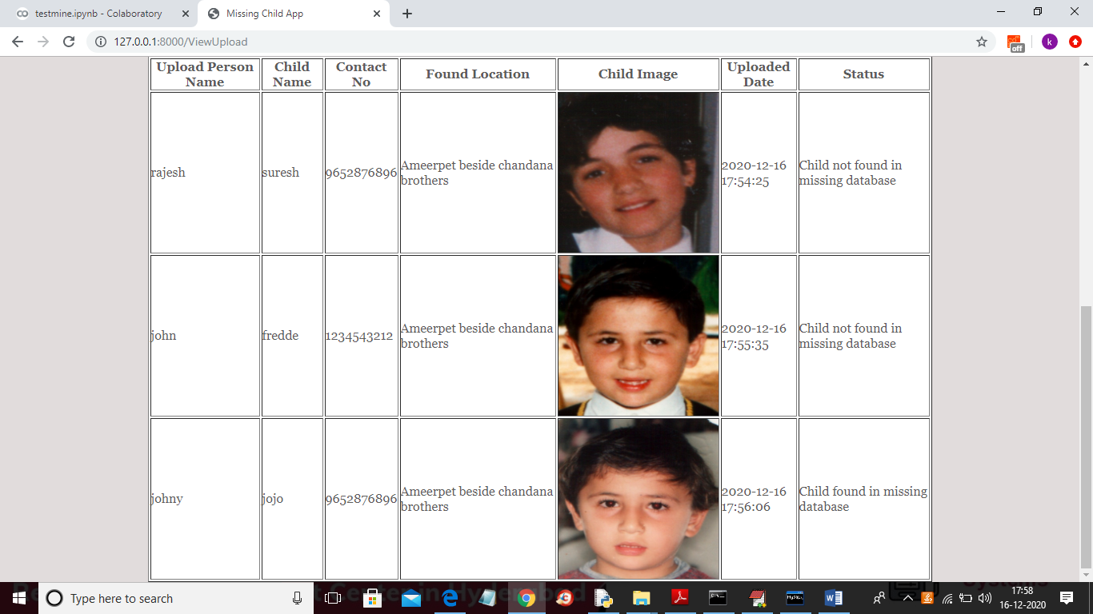
Screenshots
The database will look like this……

Slide 18
Conclusion
In this A missing child identification system is proposed, which combines the powerful CNN based deep learning approach for feature extraction and support vector machine classifier for classification of different child categories.
This system is evaluated with the deep learning model which is trained with feature representations of children faces.
Performance of the proposed system is tested using the photographs of children with different lighting conditions, noises and also images at different ages of children. The classification achieved a higher accuracy of 99.41% which shows that the proposed methodology of face recognition could be used for reliable missing children identification.

Slide 19
Thank you
Team leader: P. Sravya 21467-cm-044
B. Durga 21467-cm-005
B. Neeraja 21467-cm-009
G. Leela 21467-cm-020
G. Yamini 21467-cm-021
K. Lakshmi Sree 21467-cm-030
M. Pushpa Valli 21467-cm-037
S. Indu 21467-cm-054

